Slide 1
DocSage
Generative AI in Medicine Team - AIGn

Slide 2
Generative AI in Medicine
Generative AI models exhibit exceptional prowess in recognizing intricate textual patterns and structures making it suitable for medical field.
Large language models (LLMs) can be harnessed to elevate medical services and support healthcare professionals in multifaceted ways.
LLMs have the potential to unlock new possibilities in biomedical research due to their ability to process complex data with exceptional speed.
Patient care and experience can be significantly improved with personalized medical plans, simplified empathetic messaging, language accessibility etc.
Notes:
Generative AI is exceptionally good when it comes to

Slide 3
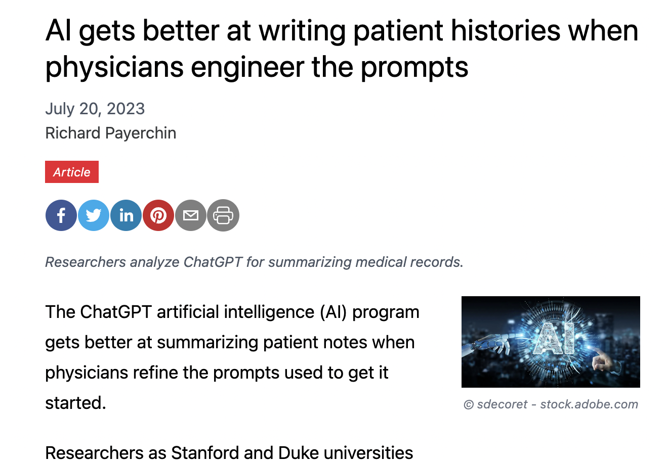
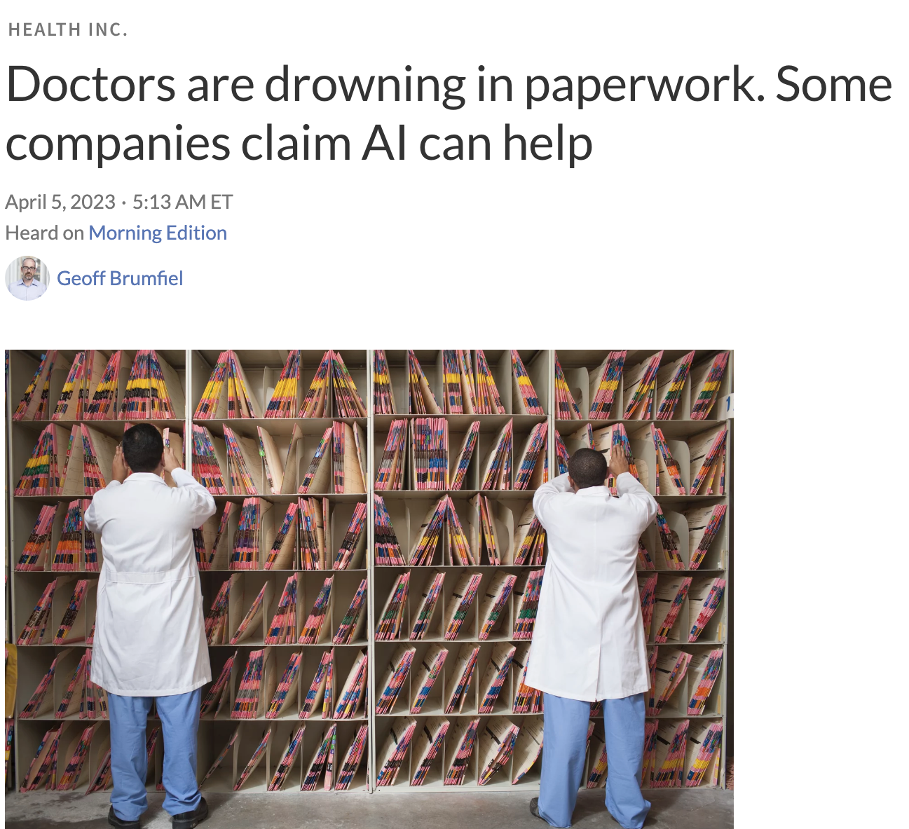
Generating Patient Summaries
Doctors/Clinicians generate summaries after every patient visit and during discharge for medical records
Summary generation is a time-consuming process since lot of complex patient data could be involved
Hospitals spend many man hours and even employ people to produce these summaries
These human generated summaries can be error prone or missing critical details

Slide 4
Predicting Medical Diagnosis
Pros
Assist nurses/paramedics where doctors are understaffed
Suggest alternate treatment plans
Predict need for laboratory tests
Validation of doctor’s diagnosis
Cons
Immature model can cause harm to people
Cost and Accessibility
Medical providers can be coerced into taking wrong decisions
Privacy and ethical concerns
Large Language Models (LLMs) can be fine-tuned data on diseases, symptoms, and their medical diagnoses derived.
These models can predict differential diagnoses for patients by analyzing their current symptoms and medical histories.
They can identify complex patterns in the medical summaries/reports to construct insights
Models can provide references and reasoning for their diagnostic results, enhancing the trustworthiness of their recommendations.
Through Reinforcement Learning with Human Feedback, these models to continually improve their diagnostic accuracy.

Slide 5
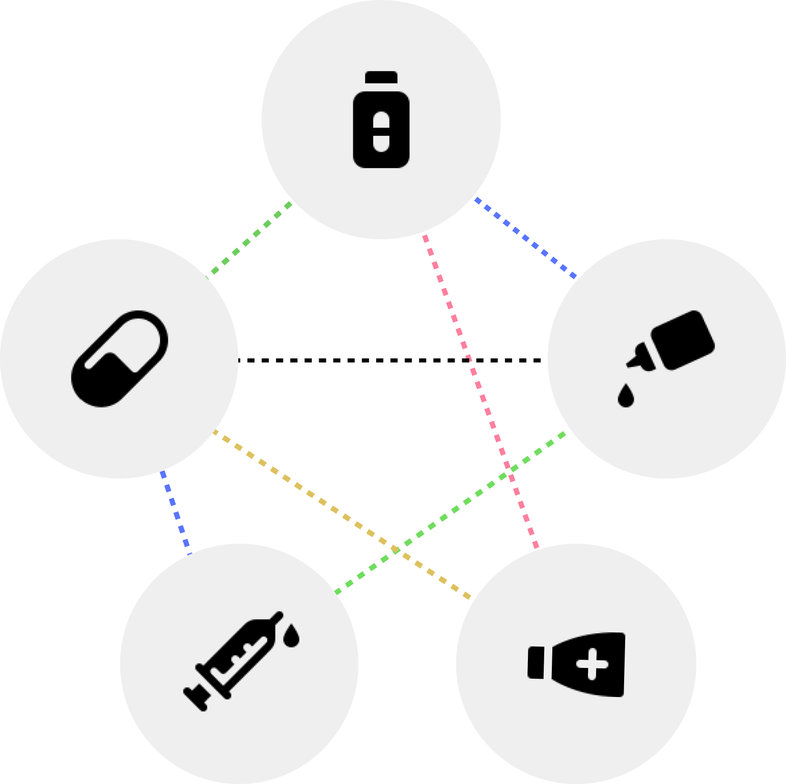
Drug Interaction Analysis
Certain combination of drugs can cause ill side effects in humans.
Pharmacies do drug validations before giving out the drugs. Pharmacists confirm that the prescribed drugs not conflict with any drugs that the patient is already taking.
LLM models can be trained on the drugs, their compositions and the effects on humans
These models can accurately predict the conflicting drugs and can be used to warn the doctors
Gen AI can also be used to suggest the safer alternate medicines for the patient’s diagnosis

Slide 6

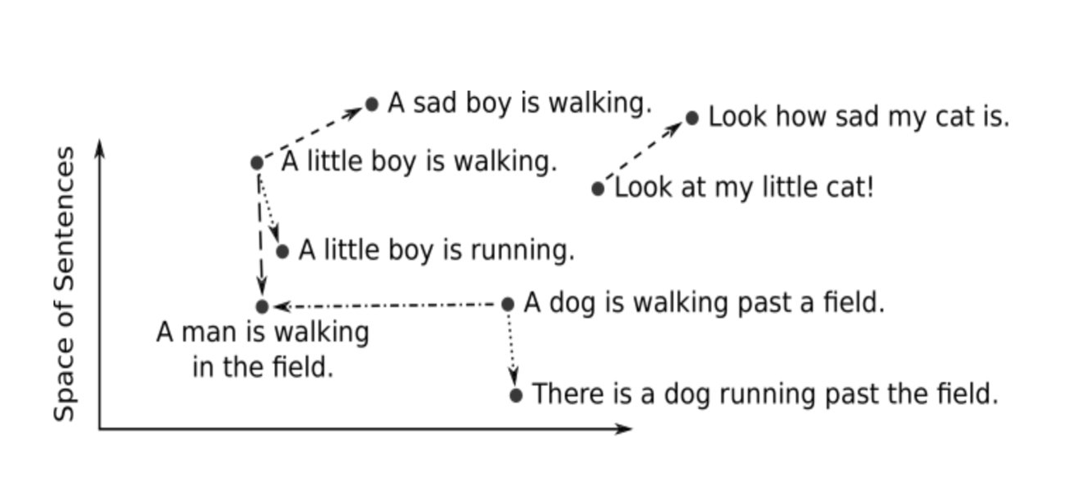
Semantic Search with LLMs
With Generative AI we can create a text semantic based search with which we can search for content with its meaning or reference
Patients who came in with a broken leg
Result
LLM models can create vector embeddings that represent text meanings and relationships
Patient Name: John Smith Patient id: 7023 Age: 70
Gender: Male
Summary: The patient presented to the hospital with a complaint of severe pain and deformity in the left leg due to traumatic injury. The patient sustained a left leg fracture as a result of a traumatic incident.
Data that have similar meaning will be closer to each other in the vector representation than the ones that have different meaning
Using cosine similarity, the data contextually similar to the search term can be fetched from the vector store

Slide 7
Semantic Search - Applications
Drug Discovery Finding compounds with specified properties. Engineering effective drugs by deriving the suitable combinations of different medicinal components
Reference Search Helping doctors find relevant research documents and references. LLMs can digest the content and its context to present it in easily understandable way
Patient EHR Search Help hospital staff with text based semantic search to find patients and their reports.
Clinical trials Find patients who are eligible for clinical trials. Currently it is being done by manually analyzing pages of medical reports

Slide 8
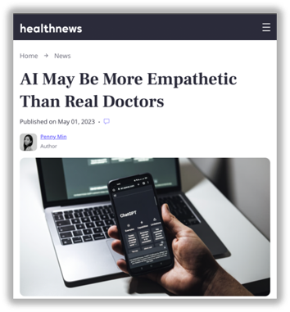
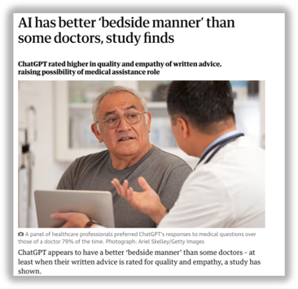
Empathetic Messaging
Empathy Communication
Doctors sometimes could lack empathy in their communication with patient due to various reasons, - Burnout and Stress
- Emotional Exhaustion
- Communication Challenges
- Individual Differences
Gen AI Solutions
- Empathetic Message Generation
- Message translation
- Simplify messages to make them more understandable
- Create training content for doctors and clinical staff to be more empathetic

Slide 9
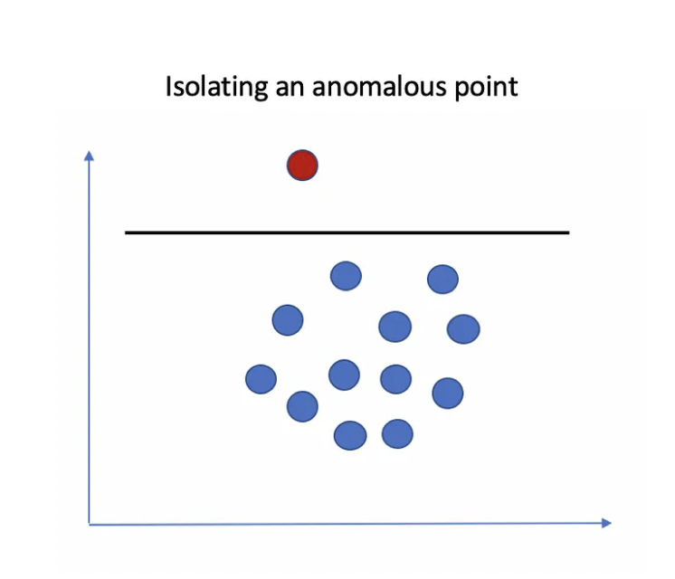
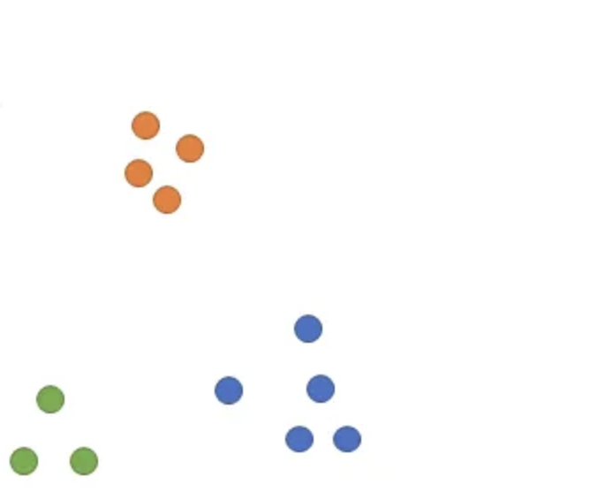
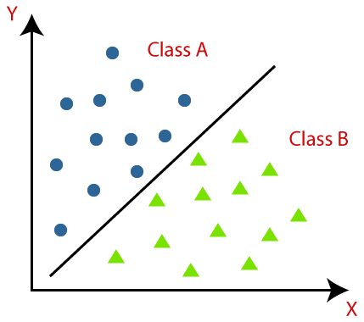
Medical Analytics
Gen AI opens possibilities to do advanced analytics over pages of textual data which is not easily achievable with traditional analytics systems
With the semantic vector embeddings of the textual data, we could do analytical operations to derive meaningful insights.
These analytics can be used to predict the spread of diseases, new epidemics, optimize hospital staffing, predict need for new hospitals/doctors etc.
Outlier Isolation
Data Clustering
Data Classification

Slide 10


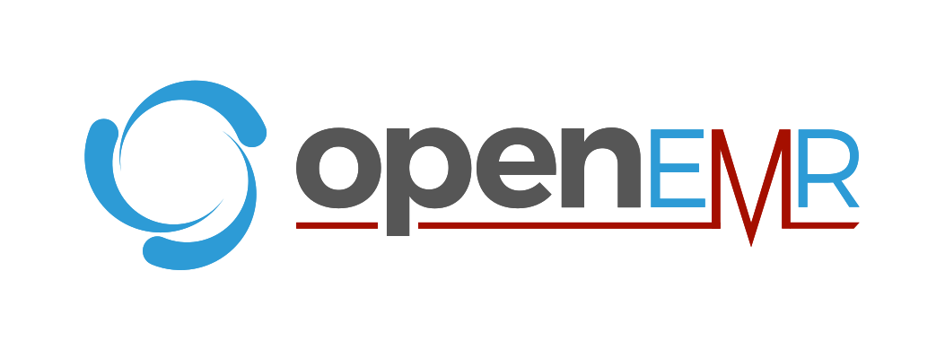



Tech Stack

Slide 11
Demo

Slide 12
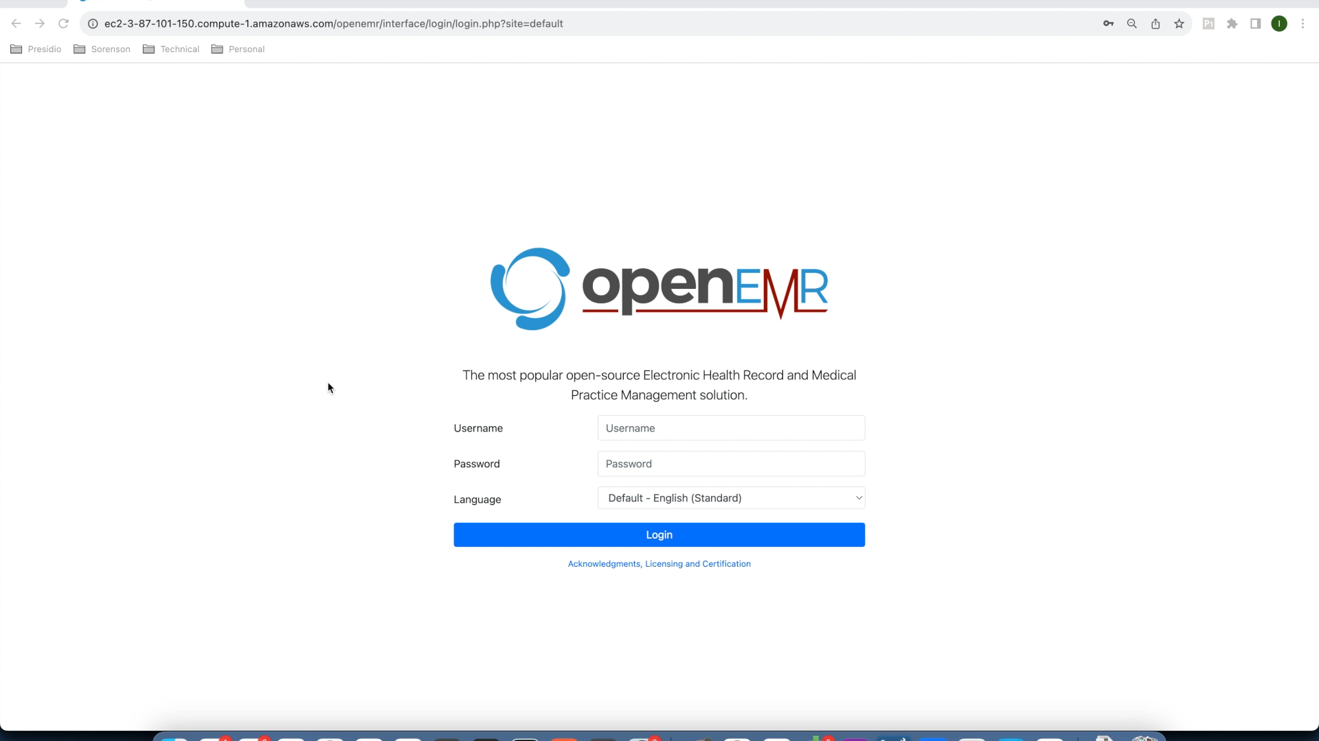

Slide 13
THANK YOU
Prabu Sampath - ps@presidio.com
Sarath Sampathkumar - ssampathkumar@presidio.com
Iniamudhan Baskar - ibaskar@presidio.com
Arun Kumar Chermadurai – achermadurai@presidio.com
Meenakshi Sundaram Palaniappan - meesun@presidio.com

